Slide 1
Invaders from Space
ECE 540 Winter 2019
Bradon Kanyid - Video & Input Hardware
Jamie Williams - Assets & Sound Hardware
Brian Henson - Software Lead
Grant Vesely - Software Intern

Slide 2
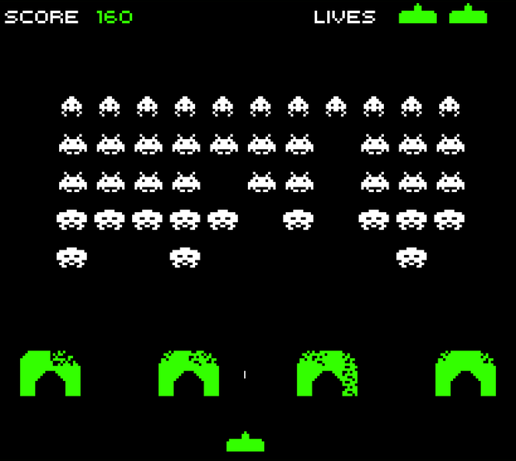
The Goal: this, but better!

Slide 3
List of Features
Base
Stretch
Space Invaders style game running on the Nexys A7 board
Controlled using Atari Paddle Controller(s)
VGA display at 1024x768
Score calculation and display (7seg & VGA)
Start menu with game options
Multiplayer gameplay (with 2nd controller)
Sound effects via Nexys audio output*
Upgraded graphics and animations
Additional game modes/enemies/power-ups

Slide 4
Controller Input and Video: Bradon Kanyid
Atari Paddle controllers (analog turn + 1 button)
Special PMOD port for A2D, XADC IP module included with Vivado
Convert 2 analog inputs to 2x12-bit values, filter, expose to software via AHB
Simple PCB that holds the interface to the paddles

Slide 5
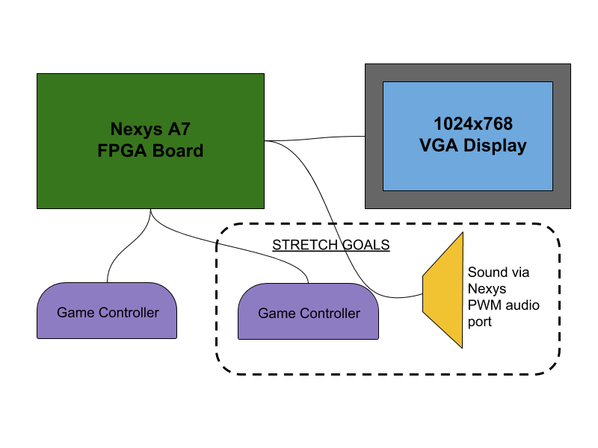
Controller Input and Video: Bradon Kanyid

Slide 6
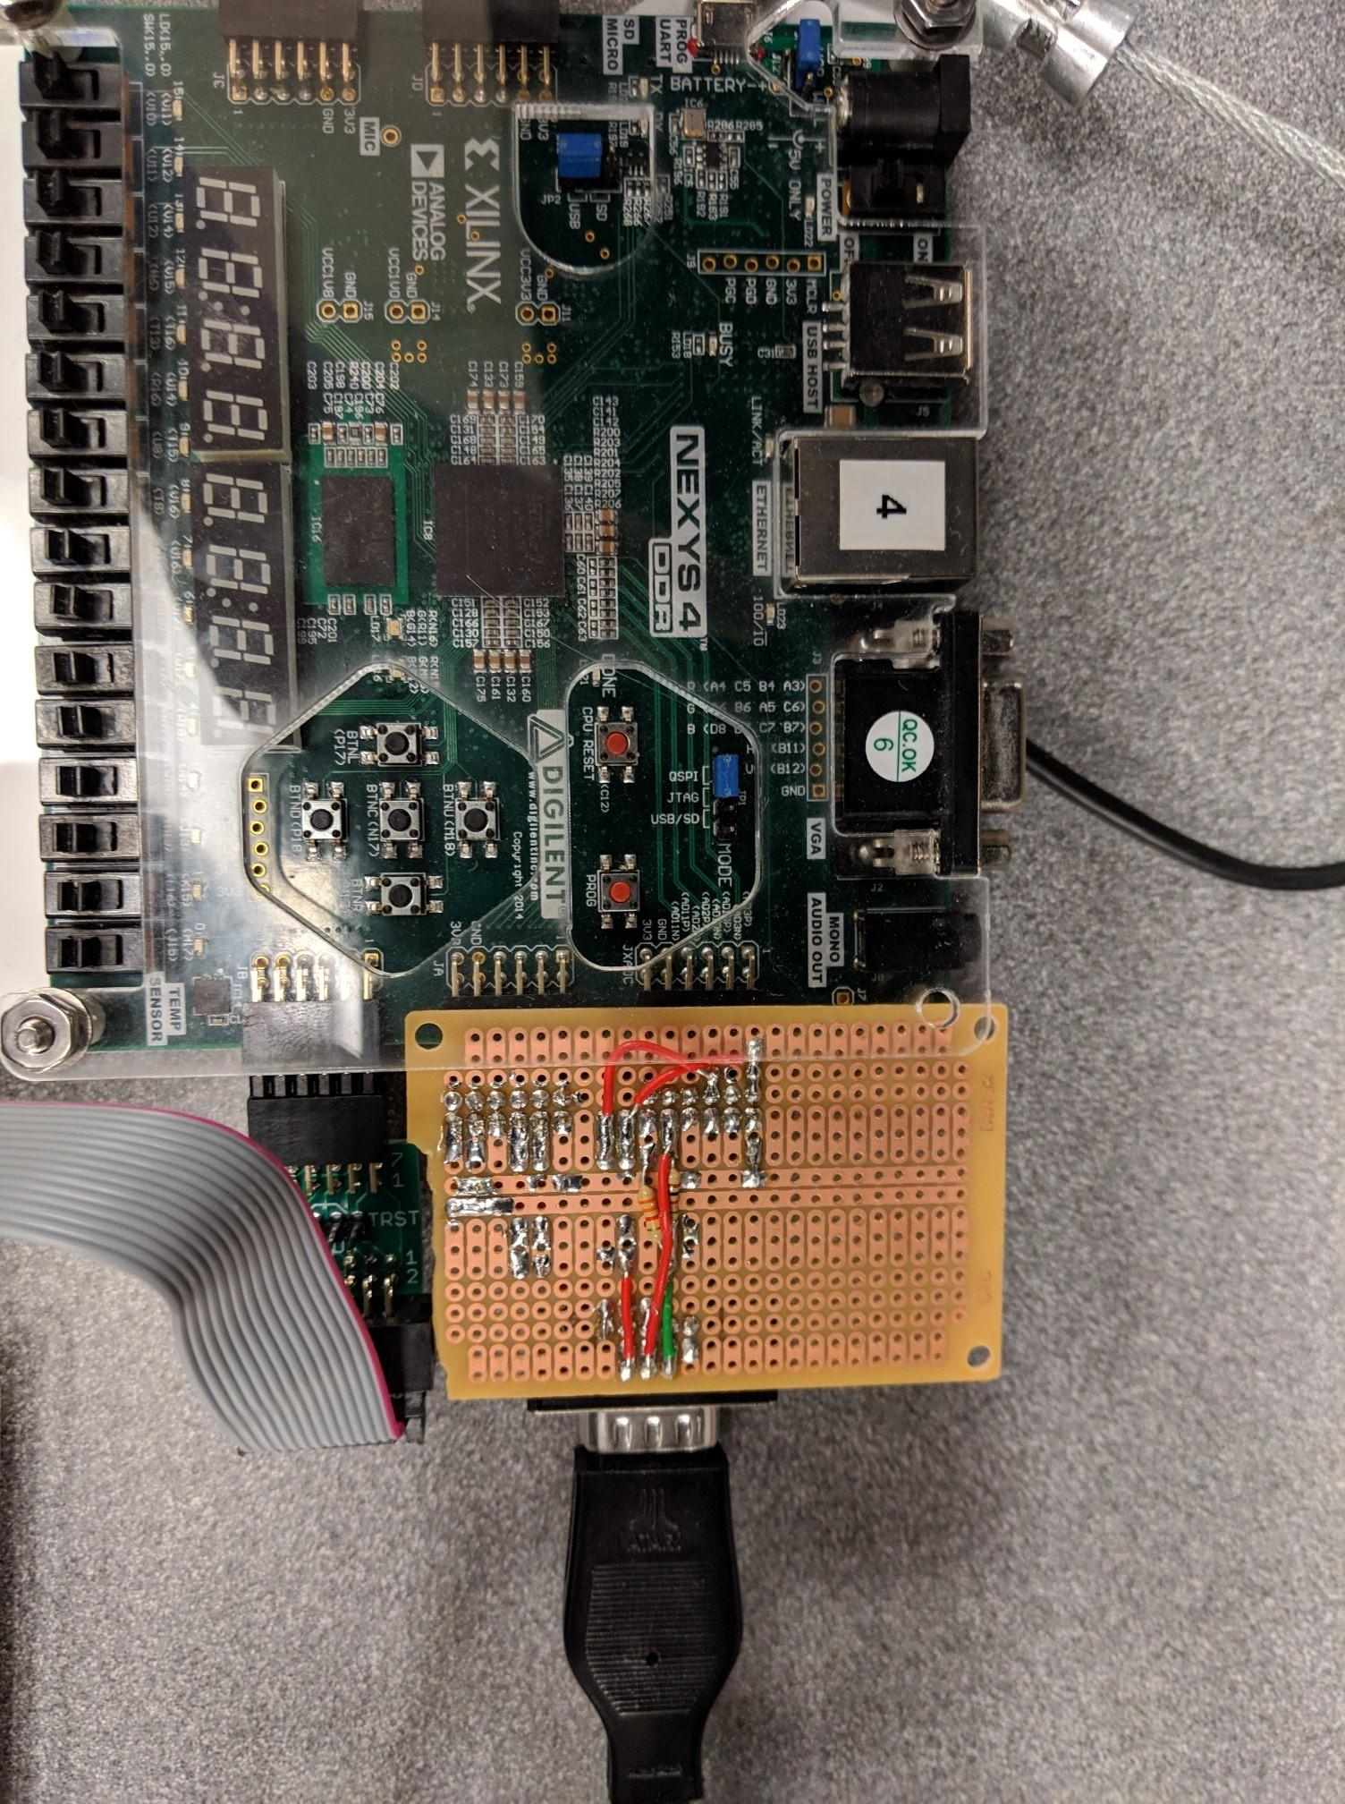
Paddle Controller Interface
Implemented on protoboard and parts from EPL.
Necessary to span two PMOD connectors, because XADC is only exposed on one PMOD for analog readings from paddle/potentiometer.
It is EXCLUSIVELY for ADC, so the 2nd PMOD connector is necessary for digital inputs (i.e the paddle buttons).
Simple voltage divider circuit to bring 3v3 input power down to 0-1V range necessary for XADC IP block, and pull-up resistors for digital buttons.

Slide 7
Video: VGA Sprite Controller
640x480@60Hz instead of 1024x768@70Hz
Allows display to scale to something reasonable. The original game was 256x224.
Pixel clock decreases from 75MHz to 25.175MHz, so timing closure was possible.
Composed of sprite palette + sprite table, exposed to MIPS as MMIO:
Sprite palette: 32-entry table where each entry holds sprite image data
Loaded from software, not hard-coded into design!
Each palette entry is 32 words (4-bit x 16 x 16)
Sprite table: 128 entries each holding sprite X, Y, index to palette entry
Complex Sprite Manager that sorts and shows only the first 16 sprites on a line, during HBLANK. Hardest part to integrate/debug.

Slide 8
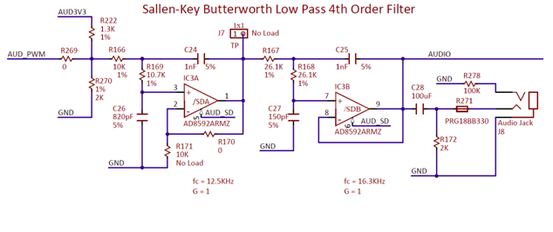
Audio Hardware: Jamie Williams
Nexys Audio
Nexys A7 board: Simple 1-bit audio out + enable
Sound driven by PWM signal
Signal filtered on board before getting to audio jack

Slide 9
Audio Hardware: Jamie Williams
Generating Audio
Done in Verilog sound generator module
Multiple PWM generator modules with outputs combined
Allows “chords” of multiple notes at once
PWM generated by creating a basic up counter
Counter max value = clock_frequency/target_frequency
If counter value under cutoff, output of 1, else 0
Cutoff value determines volume
Using block memory to store “music” sheets
Lookup table as another block memory to translate “notes” to correct frequency for the sawtooth signal

Slide 10
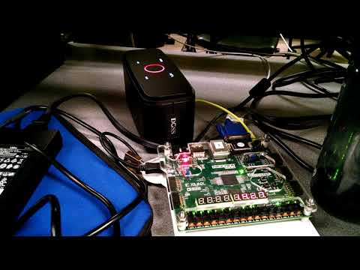
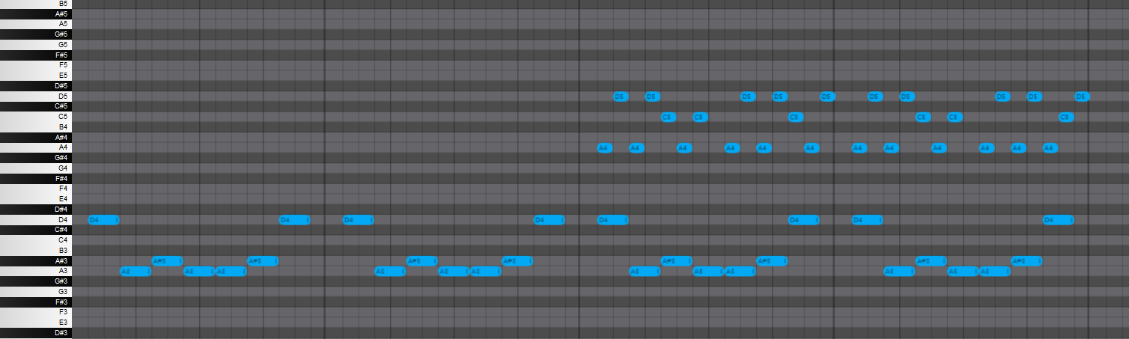
Audio Hardware: Jamie Williams
Creating Audio
Composed short background music
Comprised of two parts (sets of notes): low and high
Brian composed sound effects, but we didn’t have time to implement them

Slide 11
Audio Hardware: Jamie Williams
Audio - Issues
Worked on it’s own, but broke the game when integrated into larger project
Best guess, block memory interferes with memory crucial to game

Slide 12
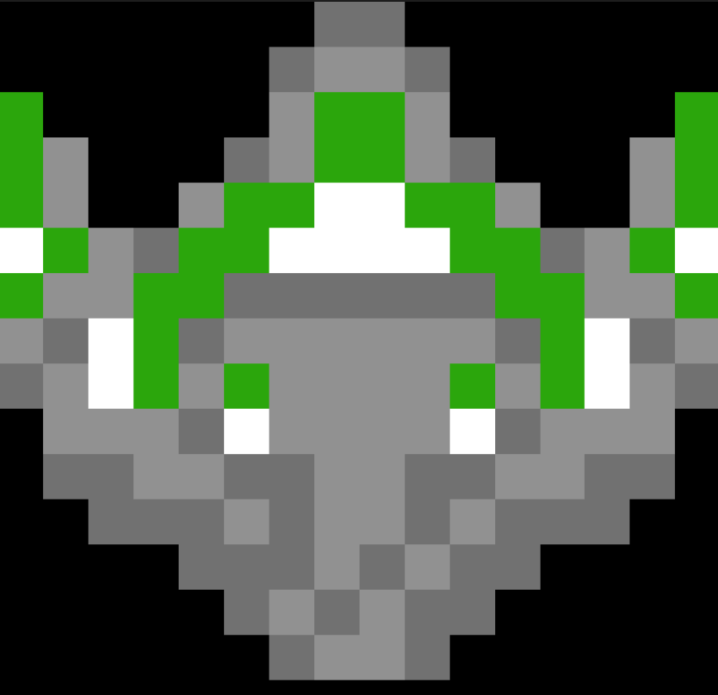
Sprites: Jamie Williams
Game Sprites
31 Custom created sprites (16x16 bits) (9 colors)
2 players
2 enemies x 2 frames (+ 1 special enemy, unused)
10 digits for score
4 for “SCORE” and “WAVE” labels
1 explosion x 2 frames
1 bullet
7 for bunker
Solid block x 3 frames
Curve block x 2 (left/right) each x 2 frames
Used 30 sprites out of 32 spots in table, 9 colors out of 15
Sprites loaded as arrays of color index values in a C file

Slide 13
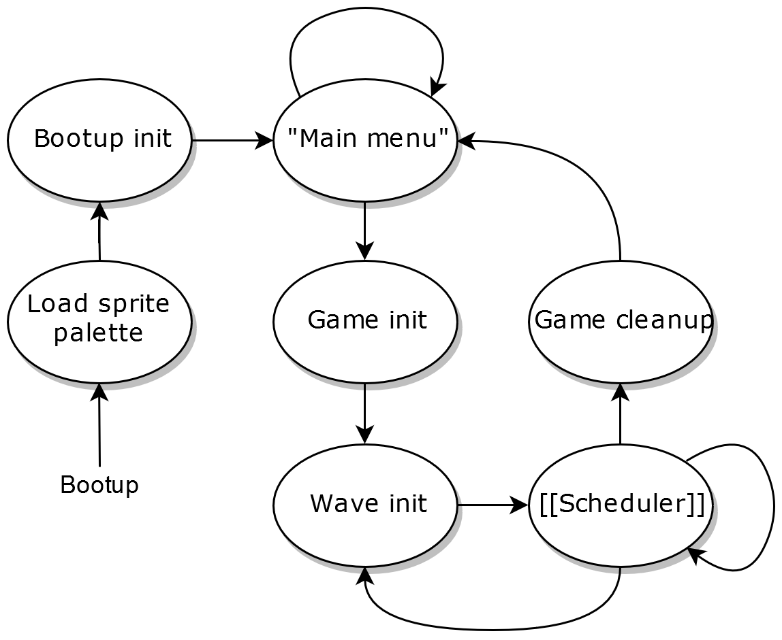
Software Lead: Brian Henson

Slide 14
Software Lead: Brian Henson
3k lines of C-code: without optimization, 92kB program file!!!
Explanation of RTOS-like Scheduler System “Gameticks” & targets
Explanation of scheduled events Move player & inputs, move enemies, move bullets, enemy shoot Animate enemy, animate player, player shoot cooldown
Parameterization 60+ defines for memory-mapped IO 120+ defines for easy game behavior tweaking
Software-loaded sprite palette
Notes:
TODO: this

Slide 15
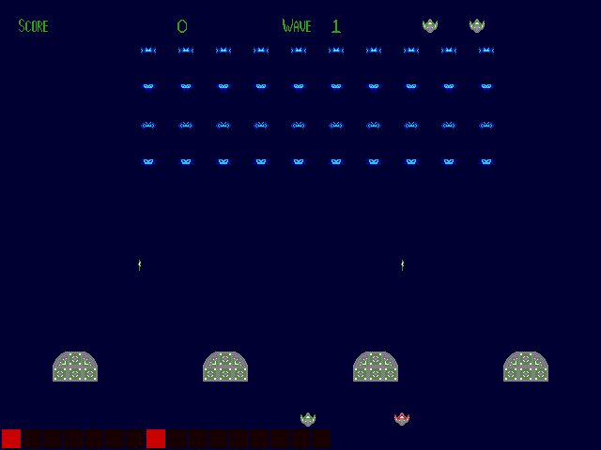
Software Emulator: Grant Vesely
Minority of game logic, but… software simulator!
Abstracted hardware-specific functionality
SDL2 media library software backend
#ifdef SDL compile-time backend switch
Allowed us to test ~5 days before hardware
Easier to debug on an OS than bare-metal, removed hard requirement for board/lab access for most of the MIPS game process.
Virtual LED display

Slide 16
The Final Result:
OUR DEMO

Slide 17
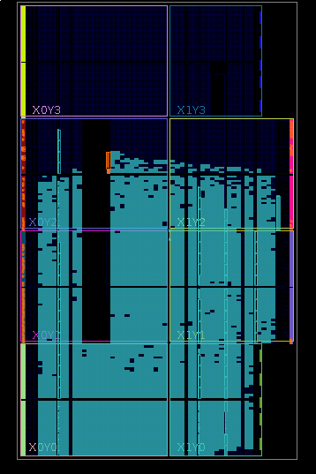
Questions?
(on design strategy or actual implementation)

Slide 18
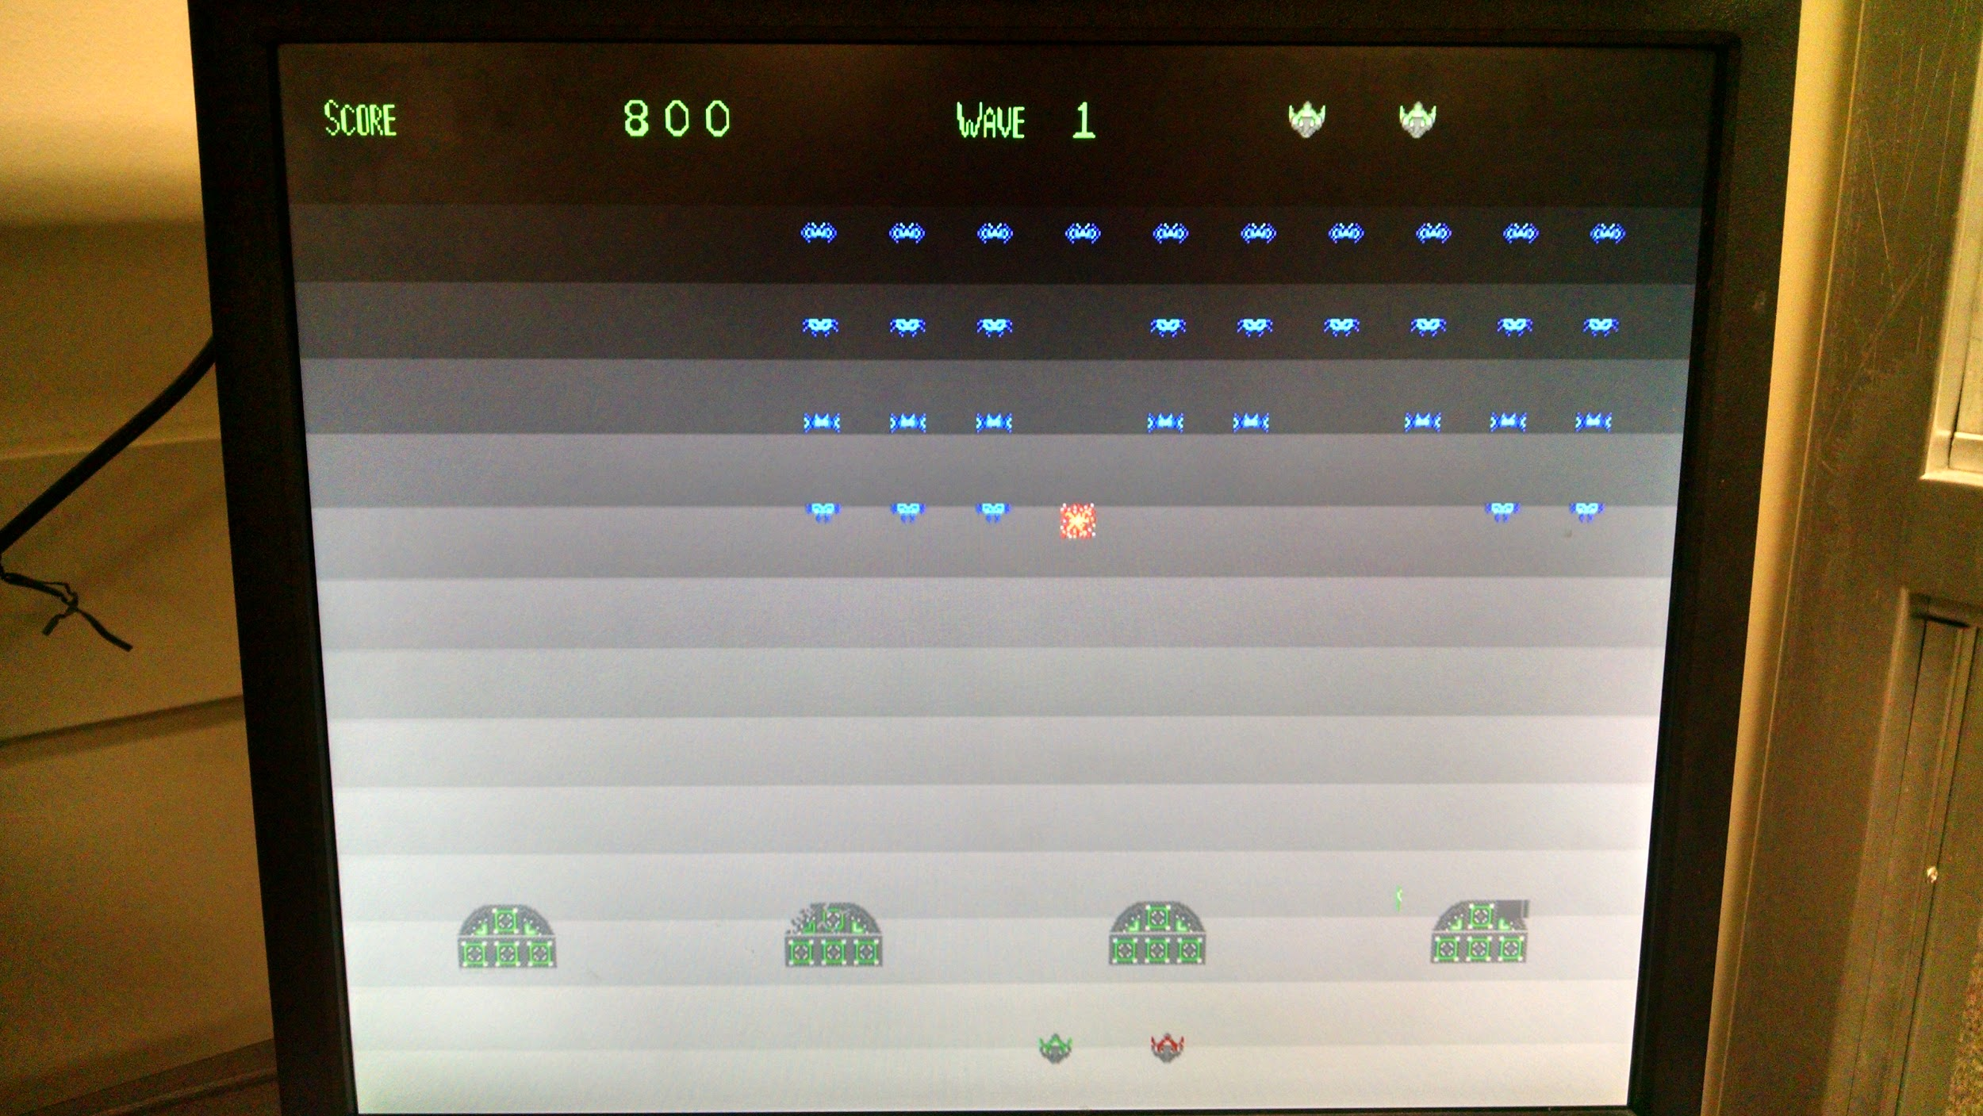
Game Screenshot

